Slide 1

EXPLORATIONS IN DATA ANALYTICS, MAT 343

Slide 2
Preliminaries
Regularly check announcements
Textbook
Syllabus
Blackboard
If you haven’t done so already, download R and Rstudio. (You might want to update your version from last semester.)
How classes will be conducted
Next Thursday’s class

Slide 3
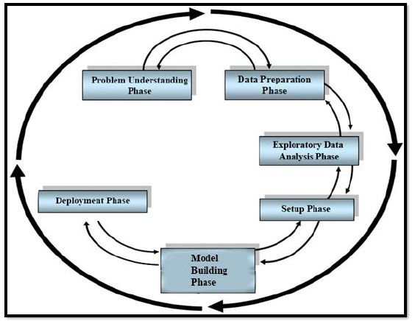
Data Science Methodology (DSM)

Slide 4
Reviewing the Phases
Problem Understanding – a two-step process:
Clearly state project objectives
Translate these objectives into the statement of a problem that can be solved using tools from data analytics
Data Preparation
Determine what data are available and how they will contribute to the solution to your problem
Clean data – fix any data quality problems (missing values, data entry errors, transform data to same units, etc.)
Prepare data for analysis – quantitative data: transform/standardize data, categorical data: combine categories
Explanatory Data Analysis (EDA)
Explore data to gain preliminary insights (one variable at a time, relationships between variables)
Be prepared for this step to send you back to Phases 1 or 2.

Slide 5
Reviewing the Phases
Setup
Cross-validation: partition dataset into training dataset and test dataset.
Validating your partition: use statistical hypothesis testing to check on randomness of our partitions
Balancing the data: re-sample cases with rare target values
Establish baseline performance
Model Building
Select appropriate modeling algorithms
Model Selection (best performance, more understandable to clients)
Fine-tune to optimize results
Evaluate models – do we need to go back to an earlier phase and start again?
Deployment
Report best models to client
Write report of your results and/or prepare presentation (adapt to audience)
Work with management to implement your models in real-world setting

Slide 6
Data Science Tasks
Description
Estimation (target variable quantitative)
Classification (target variable categorical)
Prediction (forecasts related to the future)
Clustering (identify groups of records which are similar)
Association (rules quantifying relationship between two or more attributes)
For MAT 343: Here’s where we will start:
Regression
Simple Linear Regression
Multiple Regression
Dimension Reduction
Principal Components Analysis
Logistic Regression

Slide 7
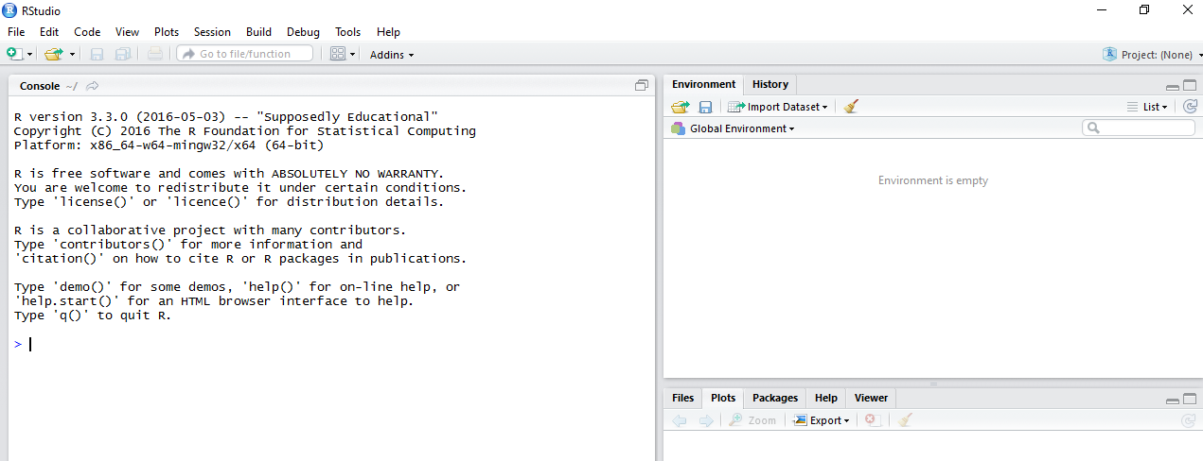
Review of R/Rstudio (See R/Rstudio folder in Blackboard)
Set up a folder for MAT 342 on your OneDrive
Open RStudio
Click + under File to open Script panel
Discuss 4 panels

Slide 9
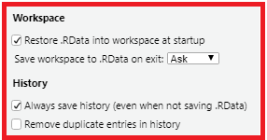
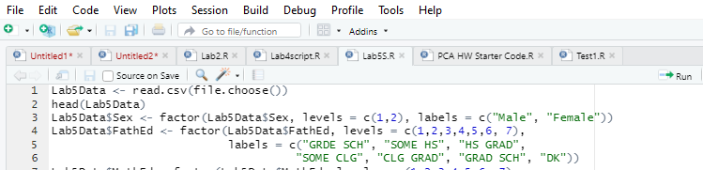
Before getting started in R
Turn off some options in Rstudio
Tools>Global Options>General

Slide 10
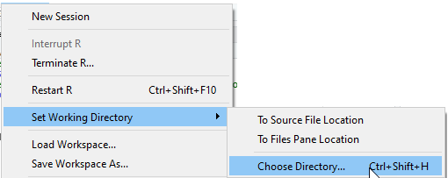
Saving Script File
Set Working Directory
Give your script a name. Here’s how:
File>Save As
Browser should open in your working directory.
Enter the name in box
Click Save

Slide 11
